Slide 1

Image Caption Generation
Abhishek DarekaR
PGAA-4

Slide 2
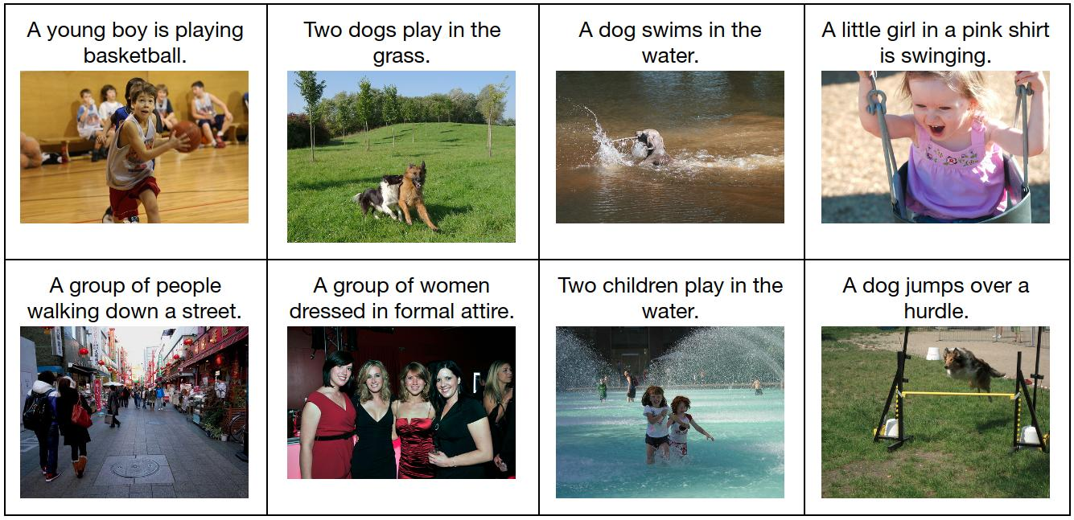
Problem Statement
To develop a system for users, which can automatically generate the description of an image.
Image captioning aims to automatically generate a sentence description for an image. Our project model will take an image as input and generate an English sentence as output, describing the contents of the image.
Some Examples of Images along with their Captions

Slide 3
Motivation
Automatically generating captions to an image shows the understanding of the image by computers, which is a fundamental task of intelligence.
For a caption model it not only need to find which objects are contained in the image and also need to be able to expressing their relationships in a natural language such as English.
Some Use Cases of Image Captioning :
Fed Ex and other courier services: Are using hand written digit recognition system from may times now to detect pin code correctly.
Provision of captions to provide HTML header and alt attribute content to improve search engine scoring of page for search terms related to the content of the movie or image.
Aid to the Blind : A product for blind people which will guide them travelling on roads without support of anyone else. This is done via Image-> Text and then simply Text-> Voice.

Slide 4
Data Source
We have used the Flick8k_Dataset from Kaggle.
Contains the 7000 images : 6000 Train and 1000 Test Images.
For Each Image we have 5 captions describing that Image. So in total we have 35000 Captions
The five different captions which provide clear descriptions of the salient entities and events.
The images were chosen from six different Flickr groups, and tend not to contain any well-known people or locations, but were manually selected to depict a variety of scenes and situations

Slide 5
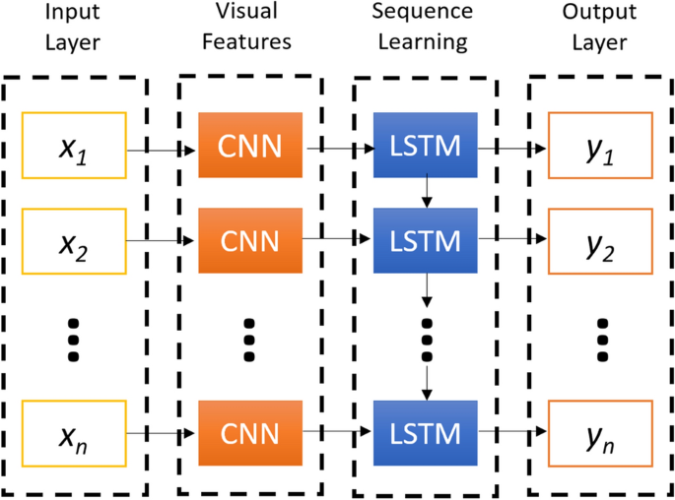
Mapping the Problem to a Deep Learning Problem.
This will be a combination of CNN and LSTM.
Evaluation of Captions Generated : BLEU(Bilingual Evaluation Understudy Score)
CNN + LSTM Architecture

Slide 6
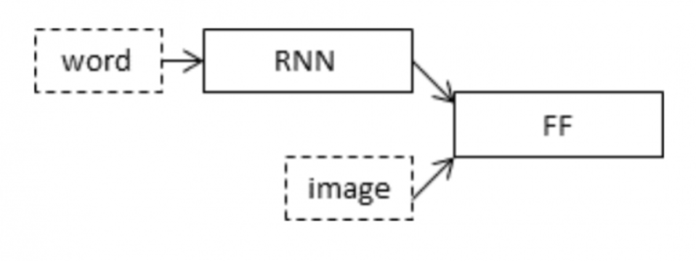
Approach
1. Approach for Images (CNN)
To encode our image features we will make use of transfer learning.
We will make use of the inceptionV3 model which has the least number of training parameters in comparison to the others and also outperforms them.
2. Approach for Text (LSTM)
To encode our text sequence we will map every word to a 200-dimensional vector. For this will use a pre-trained Glove model. This mapping will be done in a separate layer after the input layer called the embedding layer.

Slide 7
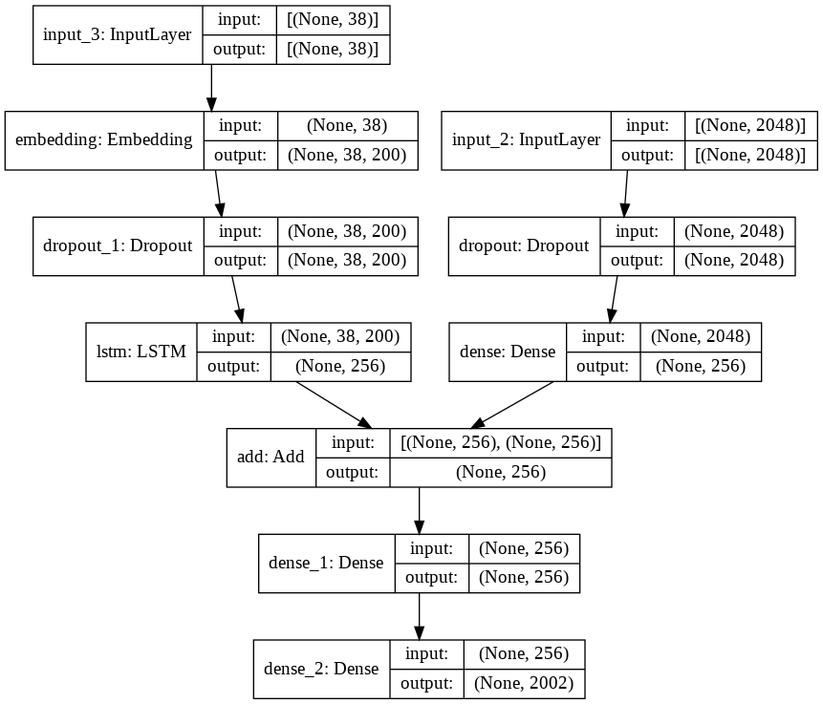
System Architecture
Input from CNN
Input Captions

Slide 8
Key Points :
1. Glove Embeddings
I have used Glove Embeddings for dealing with the Captions.
For our model, we will map all the words in our words to a 200-dimension vector using Glove.
2. InceptionV3
Removed Dense i.e. SoftMax layer as we as not interested in the output here, we just want our Image to be Vectorized.
For each Image we will have a image vector of 2048 after this.
We are creating a Merge model where we combine the image vector and the partial caption. Therefore our model will have 3 major steps:
1.Processing the sequence from the text
2.Extracting the feature vector from the image
3.Decoding the output using SoftMax by concatenating the above two layers

Slide 9
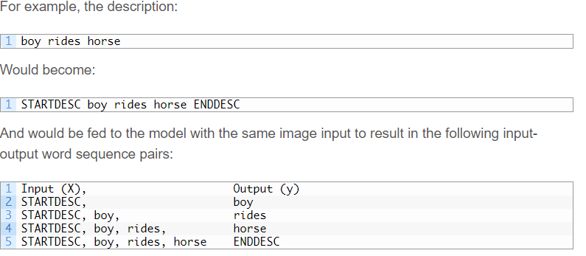
Word-By-Word Model:
A simpler model for generating a caption for photographs is to generate one word given both the image as input and the last word generated.
This model would then have to be called recursively to generate each word in the description with previous predictions as input.
Using the word as input, give the model a forced context for predicting the next word in the sequence.

Slide 10
Working of word by word model
Caption Example : “Boy in Red Shirt”
Iteration | INPUT | OUTPUT
1 | IMG , (“STARTDESC”) | BOY
2 | IMG , (“STARTDESC”, ”BOY”) | IN
3 | IMG , (“STARTDESC”, ”BOY”, ”IN”) | RED
4 | IMG , (“STARTDESC”, ”BOY”, ”IN”, ”RED”) | SHIRT
5 | IMG , (“STARTDESC”, ”BOY”, ”IN”, ”RED”,” SHIRT”) | ENDDESC

Slide 11
Greedy Search
The model generates a 2002 long vector with a probability distribution across all the words in the vocabulary.
We greedily pick the word with the highest probability to get the next word prediction.
This is how we pick only 1 word per Iteration.
This method is called Greedy Search.
This will continue till we either encounter “ENDDESC” in the output or we reach the MAXLEN i.e. 38 words.

Slide 12
Evaluate the Model
We have used BLEU score to evaluate the Captions Generated by our Model.
Bilingual Evaluation Understudy Score (BLEU) : BLEU is a metric for evaluating a generated sentence to a reference sentence.
A perfect match results in a score of 1.0, whereas a perfect mismatch results in a score of 0.0.
The primary programming task for a BLEU implementor is to compare n-grams of the candidate with the n-grams of the reference translation and count the number of matches.
These matches are position-independent. The more the matches, the better the candidate translation is.
This is an Individual Evaluation for Each Caption Predicted, No Generic Evaluation for all the Captions (All Test Data) used in this.

Slide 13
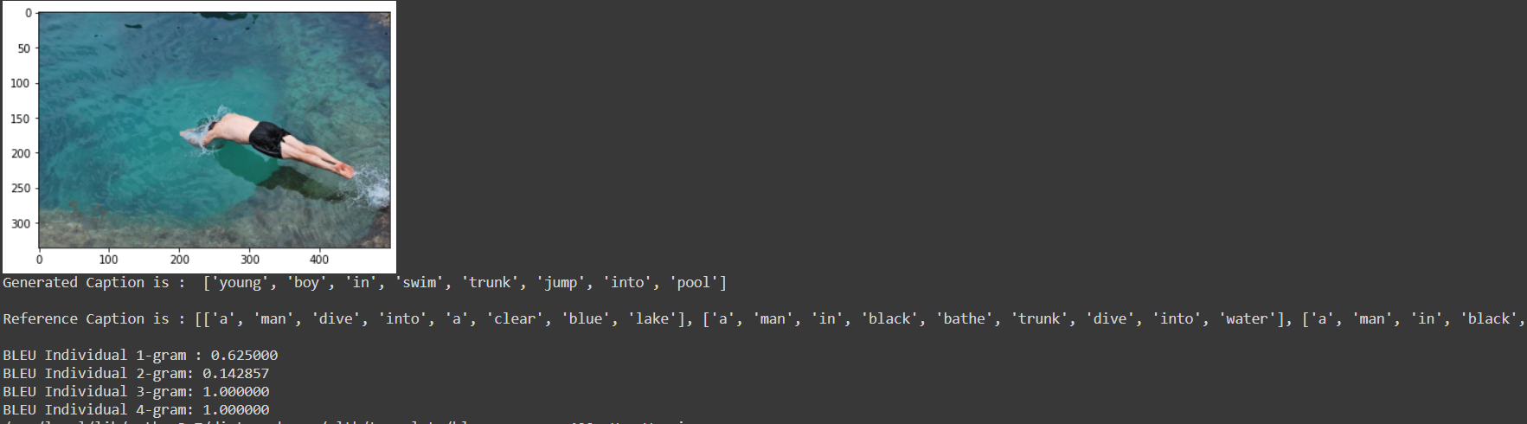
Output of the Model
-

Slide 14
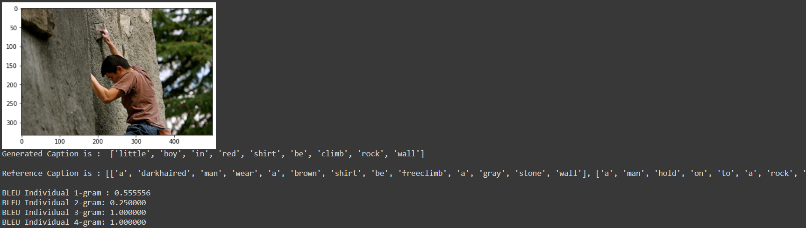
Output of the Model

Slide 15
Deployed Model
ImgCap_Deploy · Streamlit

Slide 16
Future Scope
Develop a General Evaluation Metric to evaluate all the Captions Generated.
Using higher capacity system, we can be built to develop a :
1.More complex model
2.More exhaustive training
3.Train on a Larger Dataset.
Deploy the Model to a Cloud platform.

Slide 17
Thank you!!

